Slide 1
PERSUASIVE ESSAY OUTLINE
Cats Make Better Pets Than Dogs

Slide 2

Pets
Notes:
Cat and Dog pets

Slide 3

The Intended Audience
My speech will address the general audience, especially people who keep cats and or dogs for pets.
The audience for my speech are boys, girls, and ladies, gentlemen, young and old.

Slide 4
Presentation Plan
Introduction
ii). Thesis statement: cats make better pets than dogs.
i). Opening anecdote:
It feels sick when anything unpleasant befalls your pet.
For instance, a slight accident causing an injury to a pet may cause hard feelings to the owner.
The reason behind it is that the pet has become an all-time company to people.
iii). Preview: I will praise the importance of cats in three parts:
First, I will talk about the significance of the cat’s lifespan.
Secondly, I will appreciate the alertness of cats.
Lastly, I will praise the hunting skills of cats.
Notes:
Pet has become an all-time company to people.

Slide 5
Paragraph. 1
Topic Sentence
In a research done by Turner, Bateson, and Bateson, (2000) about the domestic, the scholars hold that cats keep people company for a longer time than dogs.
Supporting sentences
Statistics have shown that cats have a lifespan longer than that of the dogs. The average lifespan of the cat is about thirteen to fourteen tears whereas that of the dog is approximately eleven years. Research has shown that large animals have a shorter lifespan than the smaller ones (Turner, Bateson, & Bateson, 2000). It qualifies the argument that cats live longer.
Concluding sentence
Therefore, the period it serves its master or gives him or her company is not nearly that of the cat.
Notes:
Cats keep people company for a longer time than dogs.

Slide 6
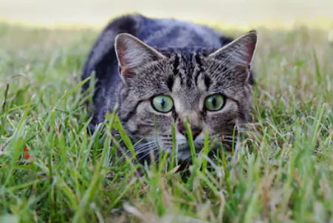

Slide 7
Paragraph 2
Topic Sentence
In another empirical research by Whitt and his colleagues (2009), it has been proven that the cat has good senses than dogs.
Supporting sentences
First, they have an acute vision, especially in the dark, unlike dogs. They can see a variety of colors than dogs and always keep a close- range vision.
Secondly, they smell better than dogs. A cat will notice the presence of an enemy (likely a rat or snake) far before the realization of a dog.
Notes:
The cat has good senses than dogs.

Slide 8
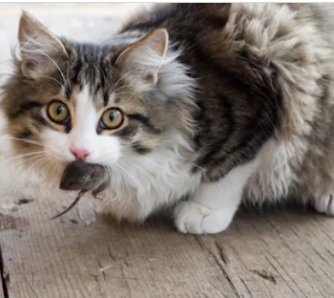
Cont... Paragraph 2
Thirdly, the cat is always alert and keeps track with any change in the immediate environment.
Concluding sentence
The dog has a congenital insensitivity and cannot realize slight changes in their environment.
Notes:
The cat is always alert and keeps track with any change in the immediate environment.

Slide 9
Paragraph 3
Topic sentence
Loss, Will, & Marra (2013) assert that the cat will do better than the dog in the art of hunting.
Supporting sentences
Coupled with the ability to see, hearing, smell and feel, the cat will notice, identify and pursue its target better than a dog.
Statistic holds that cats kill the most significant number of birds than any other animal in the United States every year.
The cat is "gifted" in making shift moves of the limbs.
Concluding sentences
Therefore, it will kill an enemy faster using bites and purges of the claws.
Notes:
The cat will do better than the dog in the art of hunting.

Slide 10
Conclusion
Cats serve their masters for a long time than they do dogs.
Also, due to their acuity senses of sight, hearing, smell and feel, cats provides the best security or alerts their masters of impeding danger.
Another attribute is that cats struggle with their enemies tactically and their hunting skills are of great importance when harmful animals invade master’s house.
Averagely, cats make better pets and therefore, people should prefer them to dogs.
Notes:
Cats make better pets and therefore, people should prefer them to dogs.

Slide 11
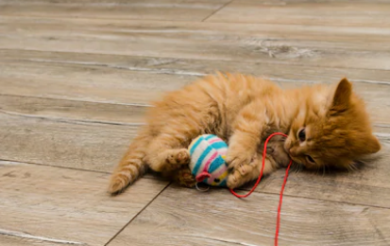
Notes:
Playing cat

Slide 12
References
Loss, S. R., Will, T., & Marra, P. P. (2013). The impact of free-ranging domestic cats on wildlife of the United States. Nature communications, 4, 1396.
Turner, D. C., Bateson, P., & Bateson, P. P. G. (Eds.). (2000). The domestic cat: the biology of its behaviour. Cambridge University Press.
Whitt, E., Douglas, M., Osthaus, B., & Hocking, I. (2009). Domestic cats (Felis catus) do not show causal understanding in a string-pulling task. Animal cognition, 12(5), 739-743.

